Slide 1

Hands-on Lab: SQL Server 2022 for Developers
Leonard Lobel
CTO, Sleek Technologies, Inc.
March 10, 2025
9:00am – 6:00pm
Level: Intermediate, etc.

Slide 2

Session Survey
Your feedback is very important to us
Please take a moment to complete the session survey found in the mobile app
Use the QR code or search for “Converge360 Events” in your app store
Find this session on the Agenda tab
Click “Session Evaluation”
Thank you!

Slide 3




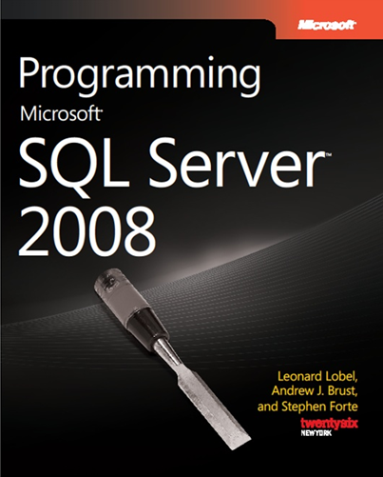
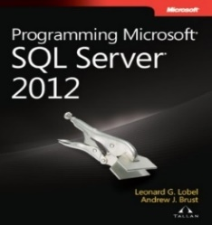
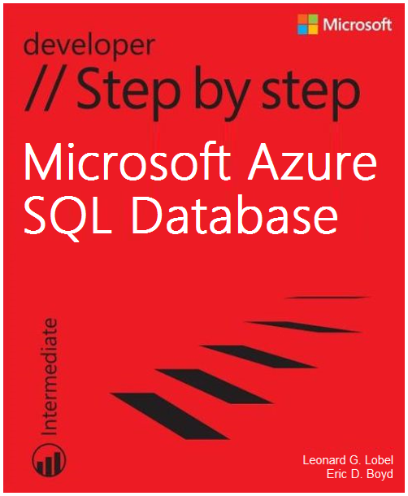
About Me
sleek technologies
Leonard Lobel
CTO & Co-Founder
Sleek Technologies, Inc.
Microsoft Consultant
Ernst & Young
Microsoft MVP
Data Platform
Trainer/Speaker/Author
Programming since 1979
Contact
Email
lenni.lobel@sleektech.com
Blog
lennilobel.wordpress.com
Twitter
@lennilobel

Slide 4
Schedule
Workshop Begins
9:00 AM
Morning Break (15 minutes)
10:30 AM
Lunch (1 hour)
12:00 PM
Afternoon Break (15 minutes)
4:00 PM
Workshop Ends
6:00 PM

Slide 5
Lab Access on GitHub
https://github.com/ lennilobel/sql2022-workshop-hol-vegas2025
(go there now!)

Slide 6
Labs
T-SQL Enhancements
Temporal Tables
Ledger Tables
Dynamic Data Masking
Row-Level Security
AI with Vectors
Notes:
https://learn.microsoft.com/en-us/azure/data-api-builder/overview-to-data-api-builder

Slide 7
T-SQL Enhancements

Slide 8
T-SQL Enhancements
Syntax | Description
DATE_BUCKET | Returns the date corresponding to the start of each bucket
DATETRUNC | Return a date truncated to any part
LEAST and GREATEST | Return the minimum or maximum value across columns
STRING_SPLIT ordinal | Returns ordinal of each split element
GENERATE_SERIES | Generate a number series resultset
TRIM enhancements | Greater control over leading and trailing characters to trim
IS [NOT] DISTINCT FROM | NULL-safe equality check
Windowing enhancements | SELECT…WINDOW, and FIRST_VALUE/LAST_VALUE enhancements
Bit Functions | Bit masking and bit manipulation

Slide 9

T-SQL Enhancements

Slide 10
Temporal Tables

Slide 11
Temporal Data
System-versioned tables
Point-in-time data access
Query updated and deleted data, not just current data
Seamless and transparent
Primary use cases
Time travel
Auditing
Accidental data loss recovery
Notes:
https://learn.microsoft.com/en-us/azure/data-api-builder/overview-to-data-api-builder

Slide 12
Using Temporal
Create an ordinary table
Requires primary key
Requires two period (start and end date) datetime2 columns
Enable the table for temporal
Creates history table with same schema, but no constraints
Automatically records updates and deletes to the history table
Query to point-in-time
Include FOR SYSTEM_TIME AS OF in your SELECT statement
Manage schema changes
ALTER TABLE automatically updates the history table
Some schema changes (e.g. new IDENTITY or computed columns) must be applied manually
Notes:
https://learn.microsoft.com/en-us/azure/data-api-builder/overview-to-data-api-builder

Slide 13
Creating a Temporal Table
CREATE TABLE Department
(
DepartmentID int NOT NULL IDENTITY(1,1) PRIMARY KEY,
DepartmentName varchar(50) NOT NULL,
ManagerID int NULL,
ValidFrom datetime2 GENERATED ALWAYS AS ROW START NOT NULL,
ValidTo datetime2 GENERATED ALWAYS AS ROW END NOT NULL,
PERIOD FOR SYSTEM_TIME (ValidFrom, ValidTo)
)
WITH (SYSTEM_VERSIONING = ON (HISTORY_TABLE = dbo.DepartmentHist))

Slide 14
Querying a Temporal Table
DECLARE @ThirtyDaysAgo datetime2 = DATEADD(d, -30, SYSDATETIME())
SELECT * FROM Employee FOR SYSTEM_TIME AS OF @ThirtyDaysAgo ORDER BY EmployeeId

Slide 15
FOR SYSTEM_TIME Variations
FOR SYSTEM_TIME AS OF a
Returns precisely one version of a row from specified point in time
FOR SYSTEM_TIME FROM a TO b
Returns multiple versions within two specified points in time
FOR SYSTEM_TIME BETWEEN a AND b
Same as FROM…TO, but includes upper boundary
FOR SYSTEM_TIME CONTAINED IN (a, b)
Returns multiple versions fully contained within two specified points in time
Notes:
https://learn.microsoft.com/en-us/azure/data-api-builder/overview-to-data-api-builder

Slide 16
Temporal Tables

Slide 17
Temporal Limitations and Considerations
Triggers
INSTEAD OF triggers are unsupported
AFTER triggers are supported on the current table only
In-memory OLTP (Hekaton) is not supported
FILESTREAM/FileTable is not supported
INSERT and UPDATE statements cannot reference the period columns
Works with other SQL Server security features
DDM, RLS, Always Encrypted

Slide 18
Ledger Tables

Slide 19
Introducing Ledger
Tamper-evident Data
Crypographically attest that all data changes are evident
Even changes made by DBAs and system administrators
Append-only Ledger Tables
For event-based scenarios
No UPDATEs or DELETEs
Updateable Ledger Tables
Tracks all changes via history table
Ledger Database
Contains only ledger tables
Database Digest
Single hash for the current state of all ledger tables in the database
Notes:
https://learn.microsoft.com/en-us/azure/data-api-builder/overview-to-data-api-builder

Slide 20
How to Detect Tampered Data
Auditing
Tracks DDL and DML operations to log files and/or event log
No cryptographic proof
DBAs can disable auditing, tamper, and then re-enable
Temporal
Tracks UPDATE and DELETE operations to separate history table
Temporal history tables can be tampered with
DBAs can disable temporal, tamper, and then re-enable
Notes:
https://learn.microsoft.com/en-us/azure/data-api-builder/overview-to-data-api-builder

Slide 21
Blockchain and Ledger
Blockchain
Decentralized and distributed cryptographic record of transactions
Overkill for centralized scenarios
High latency, low throughput, resource intensive
Ledger
Centralized blockchain technology
Tight integration with the relational database engine
Every transaction is hashed to form the blockchain
Notes:
https://learn.microsoft.com/en-us/azure/data-api-builder/overview-to-data-api-builder

Slide 22
How Does Ledger Work?
Every Transaction is Hashed (SHA256)
Generates a new block
Every Block is Hashed Against the Previous Block
Generates a blockchain
Last Block is the Database Digest
Single hash representing the current state of all ledger tables in the database
Database Digest Storage on Azure
Azure Storage immutable blobs, or Azure Confidential Ledger
Notes:
https://learn.microsoft.com/en-us/azure/data-api-builder/overview-to-data-api-builder

Slide 23

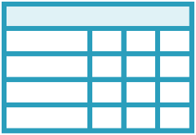
Ledger Views
Append-only Ledger Tables
Simple wrapper around the ledger table
Updateable Ledger Tables
Wraps the ledger table and its history table
Provides a readable ledger of changes
INSERT
INSERT
UPDATE, DELETE
Ledger Table
Ledger Table
History Table
Ledger View
Ledger View
Notes:
https://learn.microsoft.com/en-us/azure/data-api-builder/overview-to-data-api-builder

Slide 24
Ledger Tables

Slide 25
Dynamic Data Masking

Slide 26
Introducing Dynamic Data Masking (DDM)
Limit exposure to sensitive data by masking
Four masking functions
default – full masking; entire column is masked
partial – show starting and/or ending characters of the column data, mask the rest with a custom string
email – show the first character of the column data, mask the rest with XXX@XXXX.com
random – entire column is replaced by random values
Reveals masked data to queries
Data in the database is not changed
Enforced at the database level
No impact at the application level
Notes:
https://msdn.microsoft.com/en-us/library/mt130841.aspx

Slide 27
Masking Table Columns
CREATE TABLE Customer( FirstName varchar(20) MASKED WITH (FUNCTION='default()'), LastName varchar(20), Phone varchar(12) MASKED WITH (FUNCTION='partial(0, "_-___-", 4)'), Email varchar(200) MASKED WITH (FUNCTION='email()'), Balance money MASKED WITH (FUNCTION='random(1000, 5000)'))
ALTER TABLE Customer ALTER COLUMN LastName ADD MASKED WITH (FUNCTION='default()')

Slide 28
Masking Different Data Types
Masking Function | Behavior | Strings | Numbers | Dates | Other Types
default() | Show xxxx mask (strings), or minimum value (other types) | Yes | Yes | Yes | Yes
partial(a, 'x', b) | Show first a characters, custom mask, and last b characters | Yes | No | No | No
email() | Show first character and XXX@XXXX.com | Yes | No | No | No
random(a, b) | Show random value between a and b | No | Yes | No | No

Slide 29
Discovering Masked Columns
sys.columns
is_masked
masking_function
sys.masked_columns
Inherits from sys.columns
Filters to show only masked columns
WHERE is_masked = 1

Slide 30
Mask Permissions
DDM is based on user permissions
Create a table with masked columns
No special permission required
Add, replace, or remove a column mask
Requires ALTER ANY MASK permission
View unmasked data in masked columns
Requires UNMASK permission
Database wide in SQL Server 2016 – 2019
Granular (schema, table, and column levels)
Updating data in a masked column
No special permission
SQL 2022

Slide 31
Dynamic Data Masking (DDM)

Slide 32
DDM Limitations and Considerations
DDM cannot be used with
FILESTREAM columns
COLUMN_SET, or a sparse column that’s part of a COLUMN_SET
Computed columns
But will return masked data if it depends on a masked column
Key for FULLTEXT index
Encrypted columns (Always Encrypted)
Masking is a one-way street
Once masked, the actual data can never be obtained
An ETL process from a source with masked columns results in an irreversible data loss when loaded into the target environment
Notes:
https://msdn.microsoft.com/en-us/library/mt130841.aspx

Slide 33
Row-Level Security (RLS)

Slide 34
Introducing Row-Level Security (RLS)
Restrict access to individual rows in a table
Create predicate functions (inline TVF)
Write custom logic to control user access to every row
Security policy
Bind the functions to tables as a filter or block predicate
SQL Server filters and blocks user access to individual rows
Can enable/disable the policy as desired
Notes:
https://msdn.microsoft.com/en-us/library/dn765131.aspx

Slide 35
Filter and Block Predicates
Filter predicate
SELECT, UPDATE, DELETE
Can’t select, update, or delete rows that violate the predicate
Block predicate
AFTER INSERT, AFTER UPDATE
Can’t insert or update rows to values that would violate the predicate
BEFORE UPDATE, BEFORE DELETE
Can’t update or delete rows that violate the predicate
Implied when combined with filter predicate
Notes:
https://msdn.microsoft.com/en-us/library/dn765131.aspx

Slide 36
RLS Security Policy
Predicate | SELECT/UPDATE/DELETE rows that violate the predicate | INSERT rows with violating values | UPDATE rows to violating values
Filter | No | Yes | Yes
AFTER INSERT block | Yes | No | Yes
AFTER UPDATE block | Yes | Yes | No
BEFORE UPDATE block | No | N/A | N/A
BEFORE DELETE block | No | N/A | N/A

Slide 37
Creating Security Predicate Functions
Write a security predicate function
Ordinary inline table-valued function (TVF)
Must be schema-bound
Accept any parameters of any type
Map these parameters to column values
Implement your own custom logic in T-SQL
Examine the row via the columns passed in as parameters
Determine if access should be allowed or denied
Return a scalar 1 (allow) or nothing at all (deny)
Encapsulate logic inside WHERE clause of a single SELECT statement inside the TVF

Slide 38
Creating Security Predicate Functions
CREATE FUNCTION sec.fn_MySecurityPredicate(@Parm1 AS int, ...) RETURNS TABLE WITH SCHEMABINDING AS -- SQL Server passes in column values of each row via parameters RETURN SELECT 1 AS Result WHERE ... -- Custom logic here examines the parameters (column values) -- passed in, and determines the row's accessibility

Slide 39
RLS Security Policy
Create a security policy
Add filter and block predicates to the policy
Bind each predicate function to a table
Map table columns to the TVF parameters
SQL Server will call the TVF to determine the accessibility of each row

Slide 40
RLS Security Policy Examples
With filter predicate
CREATE SECURITY POLICY sec.MySecurityPolicy
ADD FILTER PREDICATE sec.fn_MySecurityPredicate(Col1, ...)
ON dbo.MyTable
WITH (STATE = ON)
With AFTER INSERT and AFTER UPDATE block predicates
CREATE SECURITY POLICY sec.MySecurityPolicy
ADD BLOCK PREDICATE sec.fn_MySecurityPredicate(Col1, ...)
ON dbo.MyTable AFTER INSERT,
ADD BLOCK PREDICATE sec.fn_MySecurityPredicate(Col1, ...)
ON dbo.MyTable AFTER UPDATE,
WITH (STATE = ON)

Slide 41
Identifying Users for RLS
Credentials supplied for the database connection
SQL Server login (username and password)
Windows authentication
Obtain the username from DATABASE_PRINCIPAL_ID
Different strategy required for n-tier applications
Typically, all users connect to the database using the same service account from the application tier
DATABASE_PRINCIPAL_ID is the same for every user
Solution: Use new SESSION_CONTEXT feature
Store the application level user ID as a readonly value in session context
Notes:
https://msdn.microsoft.com/en-us/library/dn765131.aspx

Slide 42
Row-Level Security (RLS)

Slide 43
AI with Vectors

Slide 44
Vectorizing Text
The Buttress Trail off of Mt. Madison in the White Mountains of New Hampshire is a gorgeous but extremely difficult hike.
Text Embeddings
Numerical representations of text that capture semantic meaning
Converts text to vectors (arrays of floating point numbers)
Text Embeddings
[
0.0073009394,
0.021845104,
-0.0034178065,
0.00064748945,
-0.016015895,
:
-0.0009928773,
0.030935206 ]

Slide 45
Vector Similarity with Dot Product
DB vector 1
Query vector
DB vector 2
Query vector
Query vector
Human
0.0122667
0.0116569
0.0491139
0.1256228
:
-0.0034369
-0.0010752
-0.0271604
0.0147063
Person
0.0432821
-0.0119717
-0.0279497
0.0862448
:
0.0066879
-0.0317295
0.0166899
0.0250083
V1 * V2
0.0005309
-0.0001395
-0.0013727
0.0108343
:
-0.0000229
0.0000341
-0.0004533
0.0003677
Elephant
0.0578154
-0.0248371
-0.0200058
0.0469250
:
-0.05862
0.05253
-0.00337
0.032885
Person
0.0432821
-0.0119717
-0.0279497
0.0862448
:
0.0066879
-0.0317295
0.0166899
0.0250083
V1 * V2
0.0025023
0.0002973
0.0005591
0.0040470
:
0.0002399
-0.0011231
0.0000826
0.0011574
Person
0.0432821
-0.0119717
-0.0279497
0.0862448
:
0.0066879
-0.0317295
0.0166899
0.0250083
SUM
0.5940221
SUM
0.2963723
Compare for Larger Value
Similarity Score
Similarity Score
Person matches Human
Notes:
Dot Product: Measures both direction and magnitude. Large vectors with similar direction yield higher values.
Cosine Similarity: Normalizes vectors and measures only the angle between them (direction), ignoring magnitude.
Euclidean Distance: Measures the actual physical distance between vectors, reflecting how far apart they are in space.

Slide 46
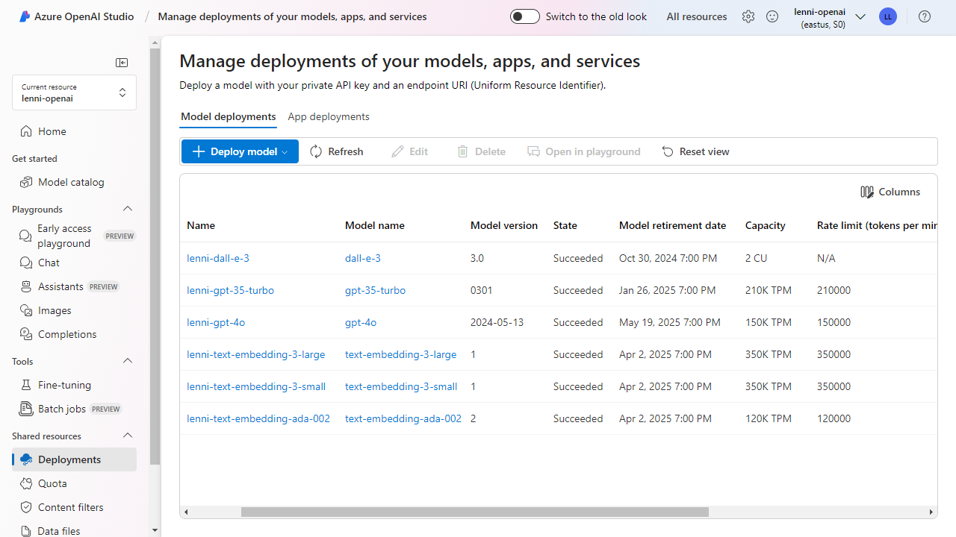

Slide 47
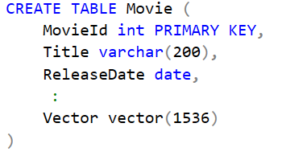

Vector Storage
Native Vector Data Type
Azure SQL Database (Preview) / SQL Server 2025 (EAP)
Notes:
Show for SQL

Slide 48
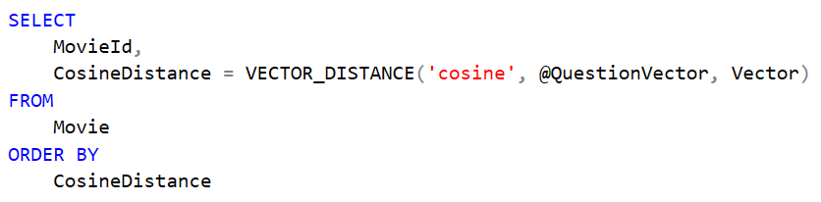
Vector Search
VECTOR_DISTANCE Function
Azure SQL Database (Preview) / SQL Server 2025 (EAP)
Notes:
Show for SQL

Slide 49
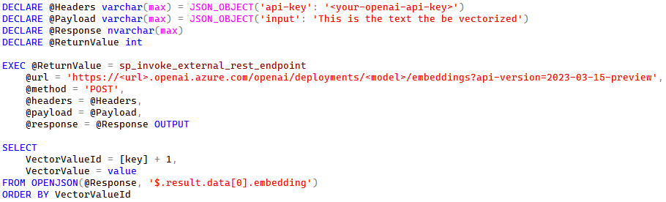
OpenAI Integration
sp_invoke_external_rest_endpoint
Azure SQL Database / SQL Server 2025 (EAP)
Notes:
https://learn.microsoft.com/en-us/azure/ai-services/openai/reference

Slide 50

RAG Solution Overview – Vectorizing Documents
Vectorize document text
Return vector embeddings
SQL Server / Azure SQL Database
Azure OpenAI
Notes:
Show for SQL

Slide 51



RAG Solution Overview – AI Assistant
3
Vectorize question text
SQL Server / Azure SQL Database
4
Return vector embeddings and run vector search
2
Text Embeddings
Send question to Azure SQL Database
Return similarity results
Azure OpenAI
AI Assistant
6
5
Answer to be generated
Completions (GPT)
8
Show answer
Return natural language answer
Ask question
7
User
1
Notes:
Show for SQL

Slide 52
Vectors

Slide 53
Session Survey
Your feedback is very important to us
Please take a moment to complete the session survey found in the mobile app
Use the QR code or search for “Converge360 Events” in your app store
Find this session on the Agenda tab
Click “Session Evaluation”
Thank you!

Slide 54
Thank You!
Contact me
lenni.lobel@sleektech.com
Visit my blog
lennilobel.wordpress.com
Thanks for coming! ☺

